Slide 1


TERRORISM DATABASE INTERCAREER INTERNSHIP (PROJECT 1)
JOY CHINENYE AKOUWA

Slide 2

CONTENT
Overview
Key Insights
Dashboards
Recommendation
Conclusion

Slide 3
OVERVIEW
This dashboard provides a comprehensive analysis of global terrorist attacks over time, examining various dimensions, including the total number, year with the highest frequency, geographical distribution, preferred weapons, targeted individuals, and impact on casualties.

Slide 4
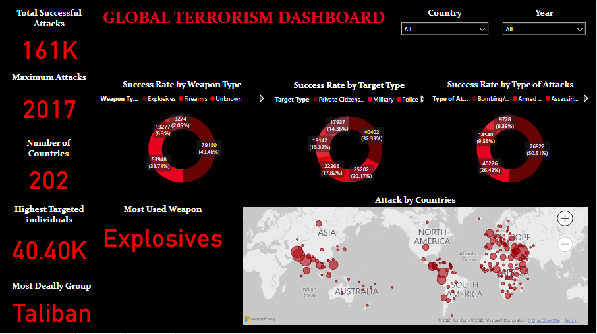
DASHBOARD

Slide 5
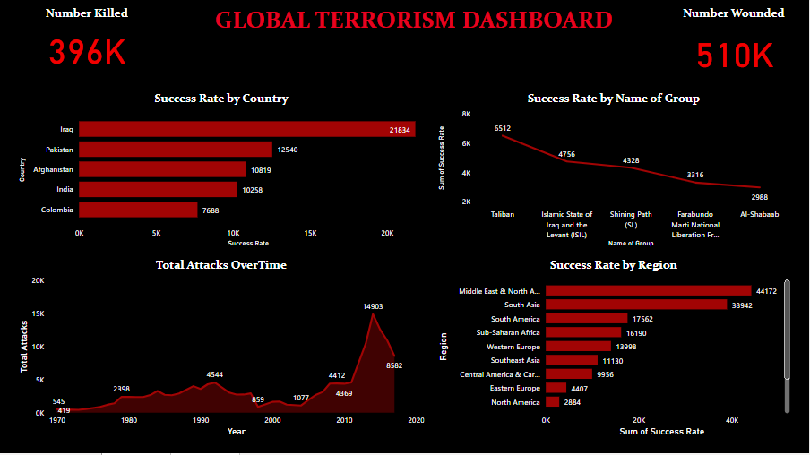
DASHBOARD

Slide 6
KEY INSIGHTS
Total Successful Attacks: 161,000 incidents occurred globally.
Year with the Highest Number of Attacks: 2017 witnessed the highest frequency of terrorist attacks.
Total Number of Countries Attacked: Terrorism affected 202 Countries.
Most Weapon Used: Explosives were the primary weapons employed in the majority of attacks.
Highest Targeted Individuals: Approximately 40,400 individuals were targeted.
Most Deadly Group: The Taliban emerged as the most lethal terrorist group.
Country with the Most Attacks: Iraq experienced the highest number of terrorist attacks.
Number of Killed: Tragically, 396,000 individuals lost their lives in these attacks.
Number of Wounded: Over 510,000 individuals sustained injuries due to terrorist incidents.
Success Rate by Region: The Middle East and North Africa exhibited the highest success rate in terrorist attacks.

Slide 7
RECOMMENDATION
Enhance international cooperation to combat terrorism, focusing on intelligence sharing and coordinates efforts.
Provide support and resources for rehabilitation programs for individuals affected by terrorism.
Strengthen counter-terrorism measures in regions with high success rates, particularly in the Middle East and North Africa.
Invest in security measures and surveillance technologies to prevent the acquisition and use of explosives.
Implement strategies to address the root cause of terrorism, such as socio-economic disparities and political instability.

Slide 8
CONCLUSION
Terrorism has a complicated global landscape that affects different regions and people differently. In order to address the complex issue and lessen the terrible effects of terrorism, a comprehensive and cooperative strategy integrating security measures, socioeconomic development, and international cooperation is needed.

Slide 9
THANK YOU

